Slide 1
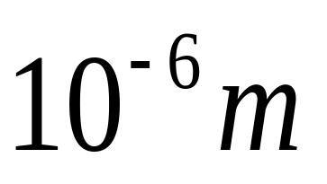
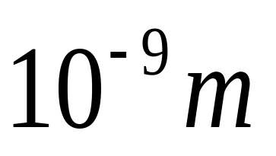
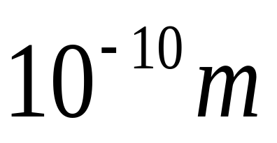
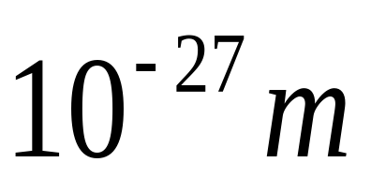
Question 123.8.1
About how big is an atom?
1

Slide 2
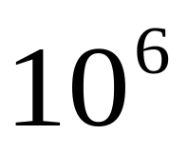
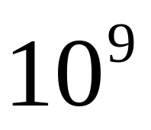
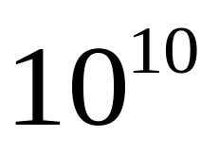
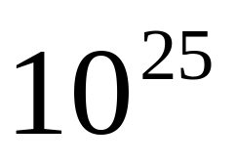
Question 123.8.2
About how many atoms (rough order of magnitude) are in a typical sample of material?

Slide 3
Question 123.8.2.5
Suppose we have 25 students in a room of volume 100m³. What would we call the quantity 25/100m³?
Crowding factor
Number density
Dating opportunity factor
Population

Slide 4
Question 123.8.3
What is a number density?
How compact numbers in a particular domain. For example, real numbers are infinitely dense
The number of something in a unit of volume
The quantity of undatable people in your FHE group
A measure of total mass of an object

Slide 5
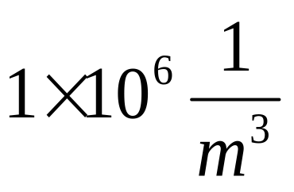
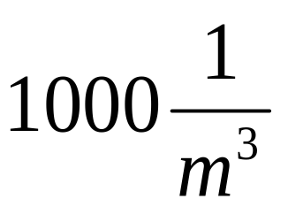
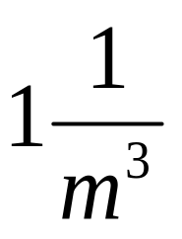
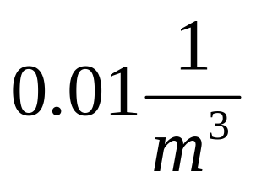
Question 123.8.4
If I have 1000 hydrogen atoms in a 1 liter volume, what is my number density?

Slide 6
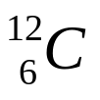
Question 123.8.5
What is the atomic weight of ?
6u
12u
14u
13.567u

Slide 7
Question 123.8.6
If I have a dozen eggs, how many eggs do I have?
6
12
13
24

Slide 8
Question 123.8.7
If I have a mole of eggs, how many eggs do I have?
6.02 x 10²³
12
1000
1.0 x 10⁸

Slide 9
Question 123.8.8
If I have 24 eggs, how many dozens of eggs do I have?
1
2
3
4

Slide 10
Question 123.8.9
If I have 1.24 x 10²⁴ eggs, how many moles of eggs do I have?
1
2
3
4

Slide 11
Question 123.8.10
Oxygen has an atomic mass of about 16u, what is the molar mass of O₂?
8g/mol
16 g/mol
32 g/mol
64 g/mol

Slide 12
Question 123.8.10.1
Which of the following properties can not be used to measure temperature?
the color of a glowing object
the length of a solid
the volume of gas held at constant pressure
number of molecules in a gas

Slide 13
Question 123.8.10.2
What might be the problem with calibrating your Celsius scale thermometer here in Rexburg, ID?
No problem, the Celsius scale is well established
Because it is so cold here, you might drop the thermometer while you work on it.
Water does not boil at 100 °C here
The scale does not work well for temperatures outside the 0 °C to 100 °C range.

Slide 14

100°C
0°C

Slide 15
Temperature from the Zeroth Law
Two objects in thermal equilibrium with each other are at the same temperature
Temperature is the property that determines whether or not an object is in thermal equilibrium with other objects

Slide 16
Question 123.8.10.3
The pressure in a constant-volume gas thermometer extrapolates to zero at what temperature?
0°C
0 K
0°F
0 Pa

Slide 17
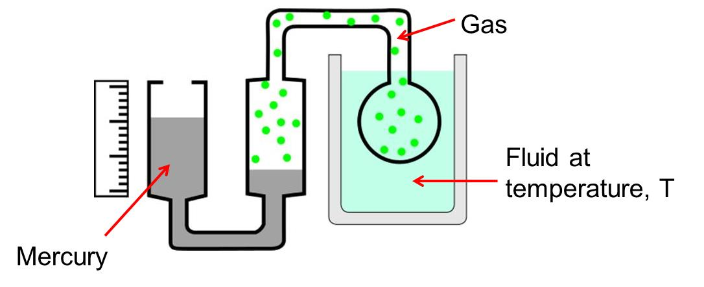
Question 123.8.10.4
We have a complicated gadget as shown. At points C and D
The pressure is the same
The pressure at point D is larger
The pressure at point C is larger
You can’t tell unless you know the pressure of the gas
C
D

Slide 18
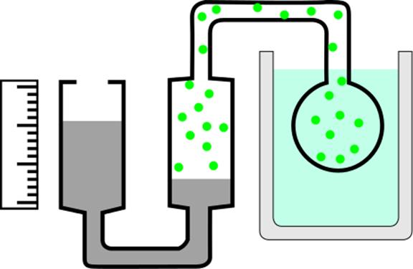
Gas
Fluid at temperature, T
Mercury
Oct 11-13, 2006
R. Todd Lines

Slide 19
P (Pa)
Temperature (°C)
-200
-100
0
100

Slide 20
P (Pa)
P = 0 Pa
T = -273 °C
Temperature (°C)
-200
-100
0
100

Slide 21
P (Pa)
P = 0 Pa
T = 0 K
Temperature (°C)
-200
-100
0
100

Slide 22
10⁹
10⁸
10⁷
Solar Interior
10⁶
10⁵
10⁴
Solar “surface”
10³
Copper Melting Point
10²
Water Freezes
Liquid Nitrogen
10
1
Liquid Helium

Slide 23
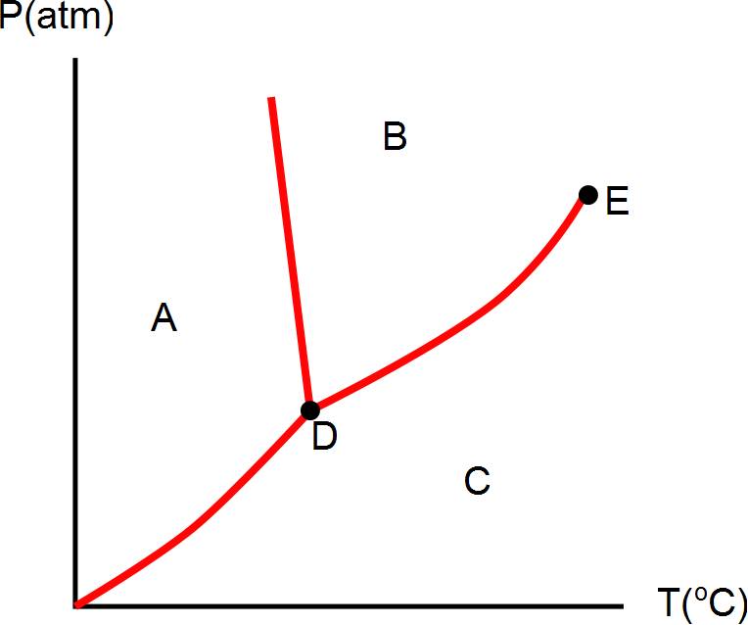
Question 123.8.11
What phase would this substance have if is were in the state represented by letter C?
Solid
Liquid
Gas
Plasma

Slide 24

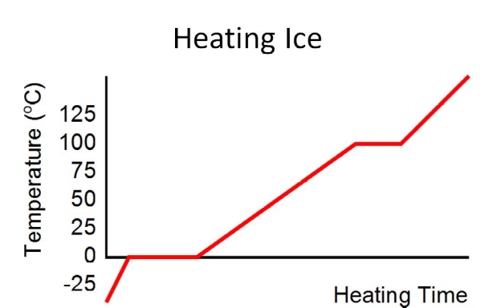
Oct 11-13, 2006
R. Todd Lines

Slide 25
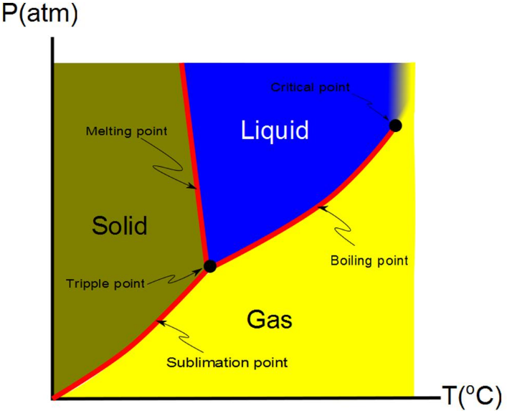
Oct 11-13, 2006
R. Todd Lines

Slide 26
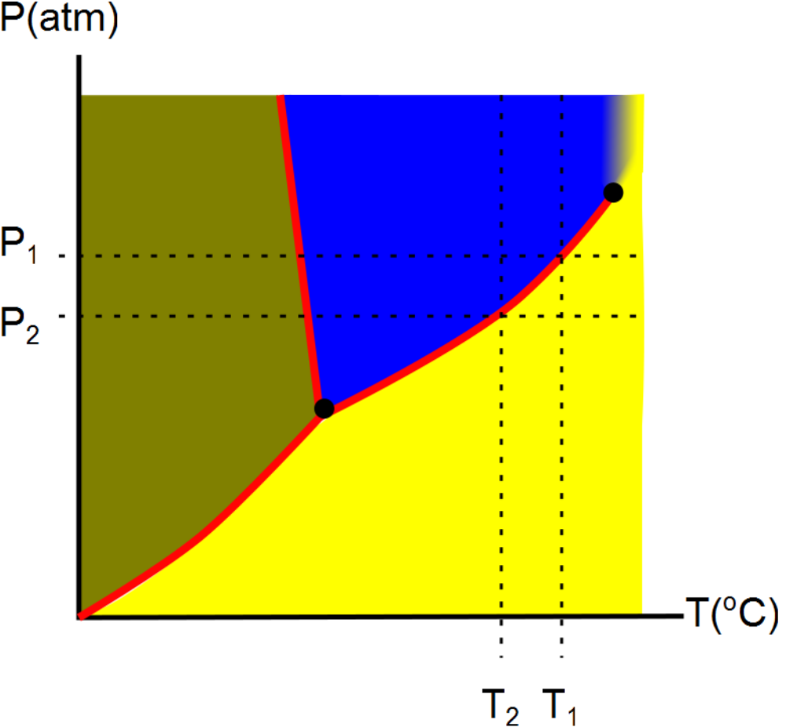
Oct 11-13, 2006
R. Todd Lines

Slide 27
Question 123.8.11
What phase would this substance have if is were in the state represented by letter A?
Solid
Liquid
Gas
Plasma

Slide 28
Question 123.8.11
What phase would this substance have if is were in the state represented by letter B?
Solid
Liquid
Gas
Plasma

Slide 29
Question 123.8.12
What is point D?
Sublimation point
Boiling point
Triple point
Double point
Critical point

Slide 30
Question 123.8.12
What is point E?
Sublimation point
Boiling point
Triple point
Double point
Critical point

Slide 31
Question 123.8.12
What do we call moving from region A to region B?
Boiling
Freezing
Melting
Condensing
Sublimation

Slide 32
Question 123.8.12
What do we call moving from region A to region C?
Boiling
Frezzing
Melting
Condensing
Sublimation

Slide 33
Question 123.8.12
What do we call moving from region B to region C?
Boiling
Frezzing
Melting
Condensing
Sublimation

Slide 34
Question 123.8.12
What do we call moving from region C to region B?
Boiling
Frezzing
Melting
Condensing
Sublimation

Slide 35
Question 123.8.12
What do we call moving from region B to region A?
Boiling
Frezzing
Melting
Condensing
Sublimation

Slide 36
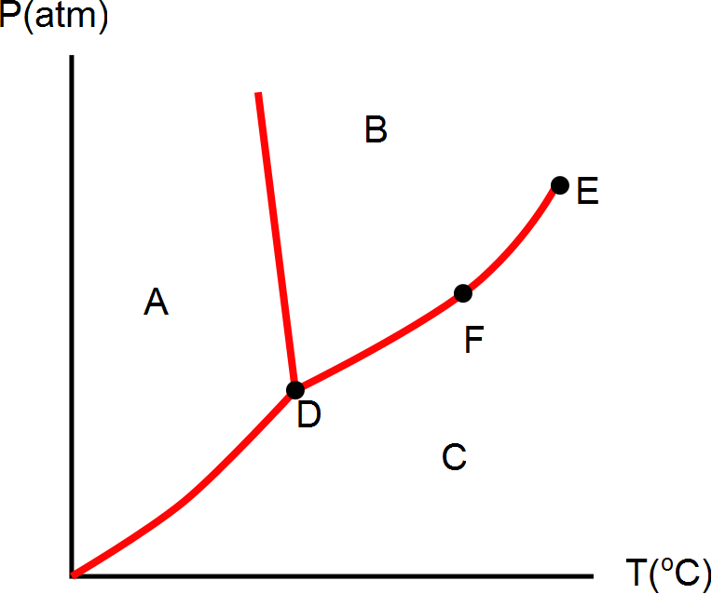
Question 123.8.12
What phase is the material at if it is in the state represented by letter D?
Solid
Liquid
Gas
Plasma
Can’t tell

Slide 37
Question 123.8.12
What can we say about the state represented by point F?
Solid
Liquid
Gas
Plasma
It is a phase equilibrium

Slide 38
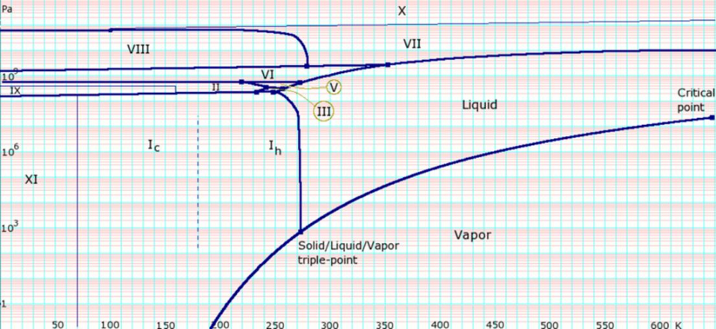
[Figure] [More Complete Phase Diagram for Water (Public Domain Image courtesy Karlhahn)]
Oct 11-13, 2006
R. Todd Lines

